Slide 1
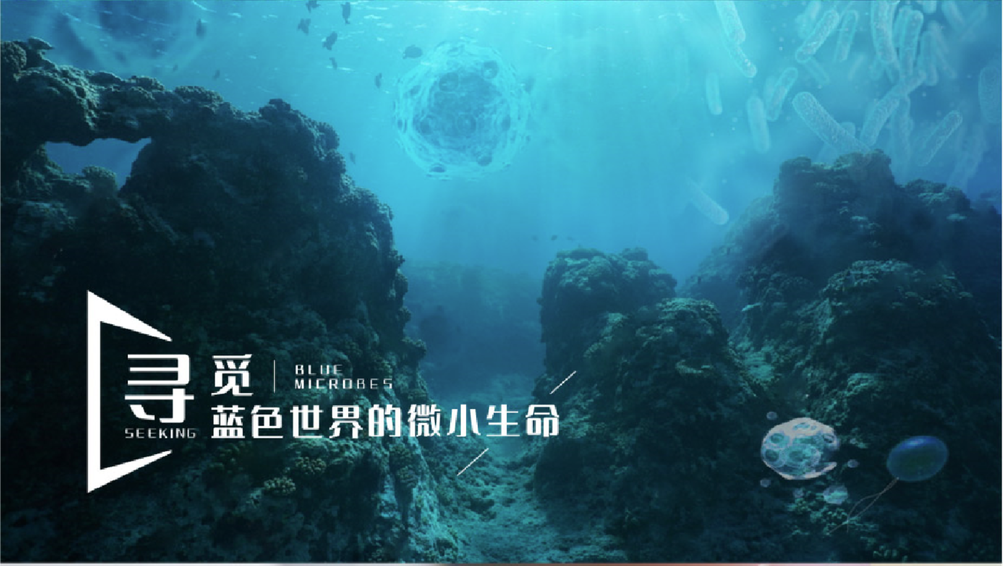
海洋微生物学及实验
2024-2025学年 秋第六周

Slide 2
Exp1 讨论题
Describe the function of oil when you use microscopes.
但油镜由于需要放大更高的倍数，其镜孔径很小，射入的光线很少，视野不明亮，物象模糊不清。
加油的目的就是让油镜与载物玻片之间加一层与玻璃折光率相近的香柏油介质，代替空气介质，使通过的光线不产生或少产生折射，增加进入透镜的光线，使视野亮度增加，能更清楚的观察物象。
答题关键：
提高分辨率，增加亮度，提高清晰度
但跟放大倍数没有关系

Slide 3
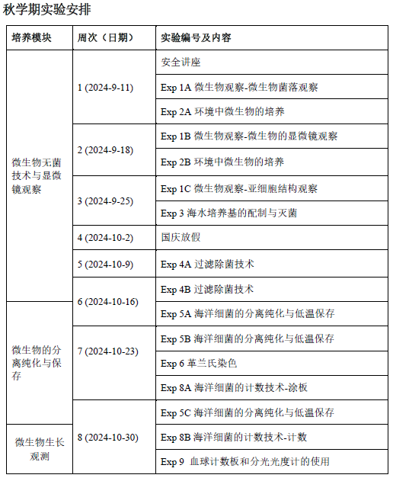

Slide 4
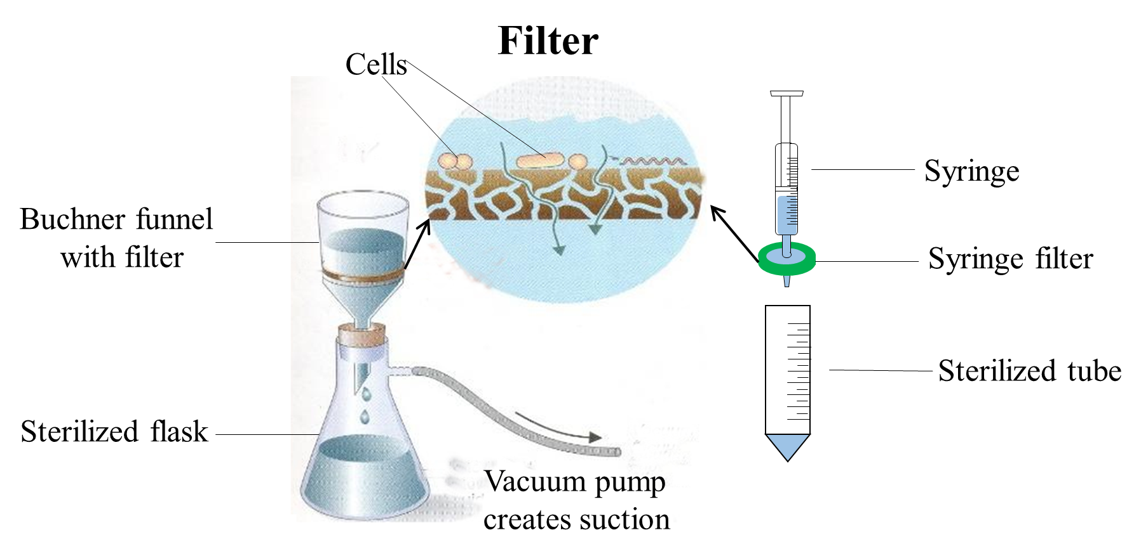
上周：
EXPERIMENT 4: Sterilization by Millipore filtration
过滤除菌技术
INTRODUCTION：
Filtration(过滤) is a great way of quickly sterilizing solutions without heating.
For removal of bacteria, filters with an average pore diameter of 0.45 or 0.22 µm is normally used.

Slide 5
OBJECTIVE
At the end of these experiments, you should:
Be familiar with liquid sterilization by Millipore filtration
Know when we use sterilization by Millipore filtration instead of autoclaving
Know how to streak out for single colonies by “streak-plate” method (streaking，划线法) from liquid.
EQUIPMENTS and MATERIALS
A laminar flow hood
Incubator
Loop
Parafilm
1 × Millipore syringe filter (0.45 µm) and a 2.5 mL syringe
2 × LB (Luria-Bertani) agar plates
1 × sterile tube
Contaminated enzyme solution (labelled E)

Slide 6

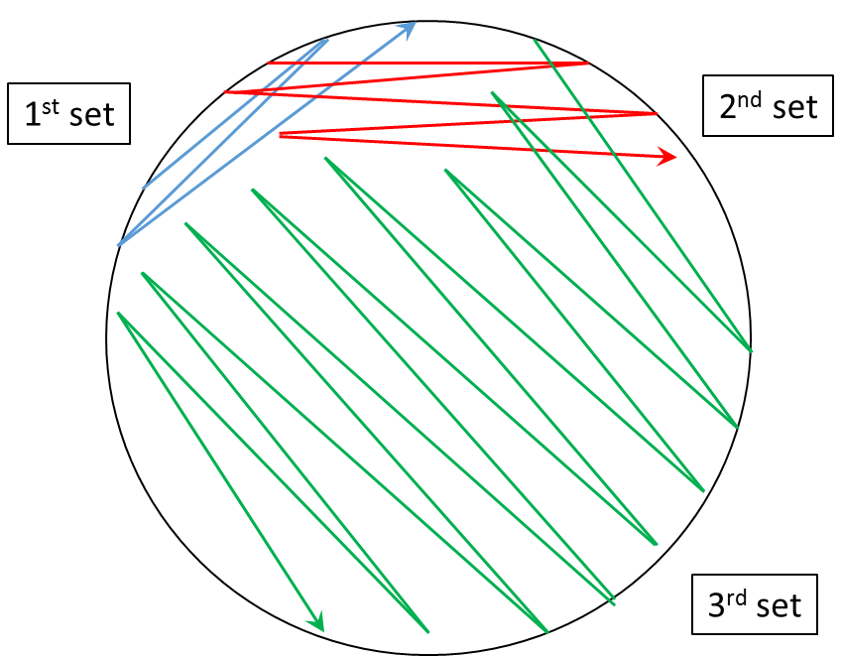
METHODS
Label two LB plates
According to Appendix E “Methods for isolation of pure cultures of bacteria”, take a loopful of the contaminated enzyme solution (labeled E) and streak out for single colonies onto a labeled LB plate (labeled “before”).

Slide 7
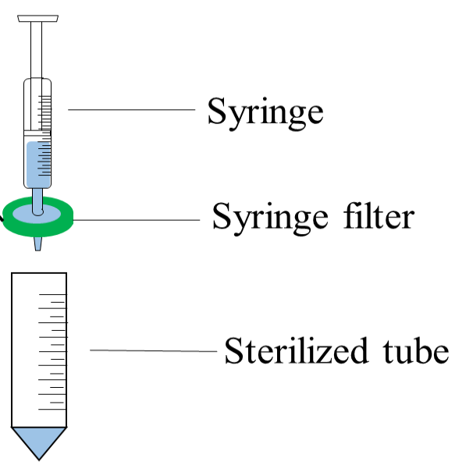
METHODS
3. As the demonstrator shows, attach one filter to one syringe, and add 1~2 mL contaminated enzyme solution into syringe. Pass the liquid through a Millipore filter into a sterile, labeled tube.
4. Aseptically inoculate a loopful of the filtered solution onto a second labeled LB plate, and streak out for single colonies.
5. Incubate both plates at 37 ºC for 24 hours.

Slide 8
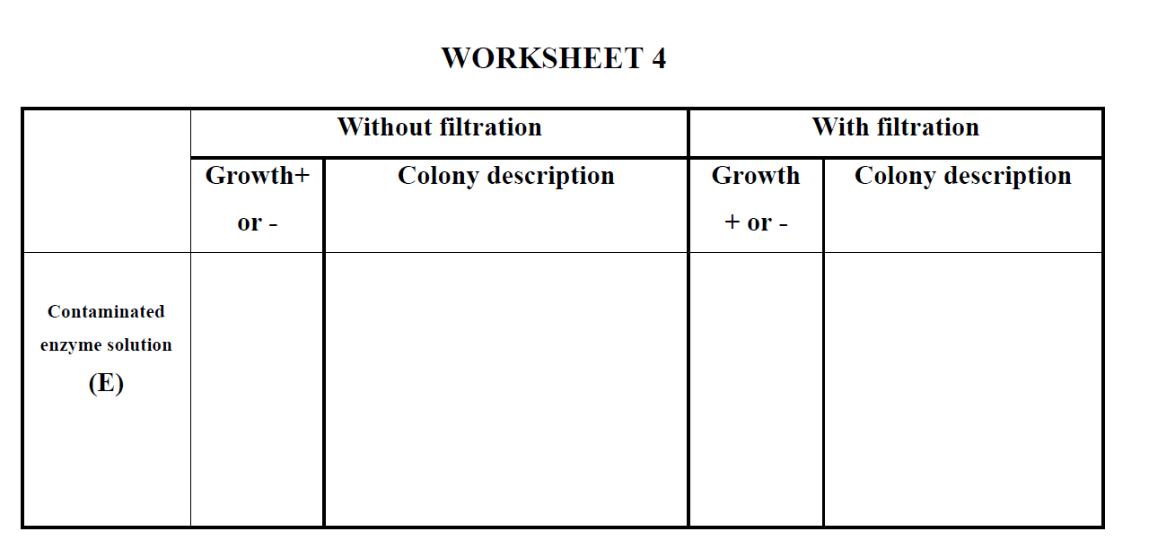
本周：
EXP 4B
METHODS
1. Examine the LB plates streaked with contaminated solution before and after filtration, for the presence of microbial growth.
2. Record your results in Worksheet 4.

Slide 9
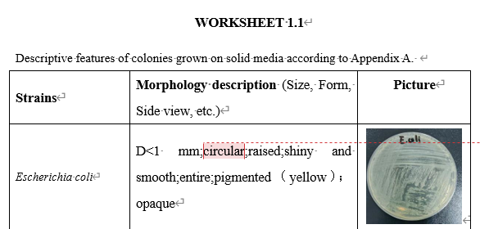

Slide 10
EXPERIMENT 5: Isolation and purification of marine microorganism 分离 纯化 海洋微生物
INTRODUCTION：
In order to characterize an individual species, a pure culture (纯培养物) is needed.
A pure culture is a population of cells arising from a single cell. A single colony (单一菌落) of bacteria on an agar plate is a pure culture of that organism.
A serial dilution (梯度稀释) and streaking (划线) are techniques used to isolate a pure strain from a single species of microorganism.
Halophiles (嗜盐菌) require sodium chloride (salt) for growth, in contrast to halotolerant (耐盐的) organisms, which do not require salt but can grow under saline conditions.

Slide 11
Bacteria on an agar plate can be stored at 4 °C for a few weeks. However, if you want to store bacteria for a longer time, you will need to establish glycerol stocks (甘油保存管). The addition of glycerol stabilizes the frozen bacteria, preventing damage to the cell membranes and keeping the cells alive. A glycerol stock of bacteria can be stored stably at -80 °C for many years.
OBJECTIVES
At the end of this experiment, you should:
Be able to isolate microorganism from a certain environment
Know the basic traits of marine microorganism
Know the differences between halotolerance bacterial and halophiles
Know how to streak a single colony from cultured plates
Know how to do the long-term preservation of microorganisms

Slide 12
EQUIPMENTS and MATERIALS
A laminar flow hood
Incubator
Vortexer 涡旋振荡器
Pipettes and tips
Parafilm
Water samples from ocean (O) or salt field (S)
Sterile Spreader (涂布器)
3 × MBA plates (from Exp. 3)
Sterile 3% (w/v) NaCl saline
50 mL sterile tubes

Slide 13
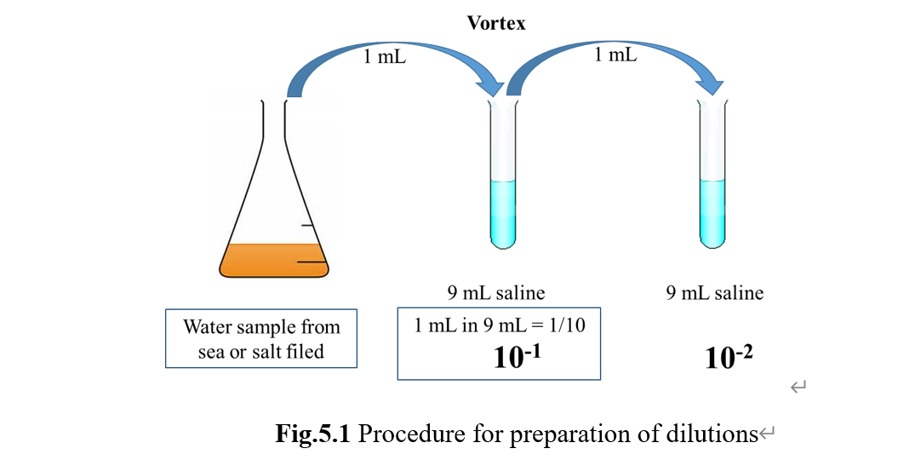
METHODS
1. Preparation of dilutions for spreading (Fig.5.1)
2. Spread plate method
Three MBA plates each group.
下周三前(10月23日)提交EXP 4的实验报告，文件名按模板建议“姓名-学号-实验报告4” ，钉钉私信提交，收到后均会回复！

